Slide 1
PROJECT 'PROCUREMENT AI AGENT'
ABU DHABI AI FACTORY STRATEGIC IMPLEMENTATION
Timeline: April 1, 2025 – March 31, 2026 (Assumption)
TPM Office: Rukhsar Ahmad

Slide 2
Core Delivery Scope
Intelligent Automation:
End-to-end automation of RFP Creation and Technical Evaluation workflows.
Deployment of Sourcing AI Agents to autonomously identify and optimize procurement paths.
System Ecosystem:
Deep integration with Oracle Fusion ERP for real-time data synchronization.
A Sovereign Cloud architecture ensuring 100% data residency and security.
Localized Excellence:
Full Bilingual Support (Arabic & English) for all AI-generated legal and technical documents.
Purpose-built models for Abu Dhabi Legal Compliance and audit-readiness.
Strategic Insights:
Real-time Analytics dashboard for monitoring vendor performance.
An AI-driven Recommendation Engine for data-backed vendor selection.
Out-of-Scope: Direct financial disbursement (payments) remains a manual function to maintain internal financial controls.

Slide 3
Strategic Vision & Mandate
• Objective:
Deploy a Sovereign AI Agent to 15+ Abu Dhabi entities.
• Efficiency(KPI):
70% reduction in RFP drafting time; 98% document accuracy, 50% decrease in procurement cycle time
• ROI:
Targeted AED 5M annual savings through process automation.
• Data Sovereignty:
100% Data Residency in Azure UAE North.

Slide 4
Part A: Project Planning and Strategy

Slide 5
Master Roadmap: April 2025 - March 2026
• Q2 2025: Mobilization, Infra setup, and 20% Data Cleansing Sprints.
• Q3 2025: RAG Engine Development and Pilot UAT (Phase 1 Build).
Phase 1 (Visibility - Oct '25): GITEX
Launch MVP at GITEX. Build trust and political capital with a high-impact demo.
Phase 2 (Connectivity - Dec '25): INTEGRATION
Deep technical integration. Bi-directional sync with Oracle Fusion ERP.
Phase 3 (Excellence - Mar '26): Go-Live
Full entity onboarding. Final Arabic legal tuning and security hardening.
• Logic: Phasing de-risks the project by securing early executive buy-in.

Slide 6
Unified Squad Structure (12 FTE)
• Leadership (Shared):
TPM (Program Governance/Risk) and Product Owner (PO) (Value/Backlog Prioritization).
• Shared Services:
Business Analyst (BA) – Gathering and data labeling for the 20% quality gap.
• Squad Alpha (Intelligence - 4 FTE):
Team: 1 Tech Lead, 3 ML/Data Engineers.
Focus: RAG pipeline, Model fine-tuning, and Data Cleansing.
• Squad Beta (Platform - 5 FTE):
Team: 3 Backend Devs, 1 UI/UX Designer, 1 QA Engineer.
Focus: Oracle Integration, UI, and Security.

Slide 7
Project Methodology - Hybrid Approach
Waterfall Layer:
Applied to Infrastructure Set-up, Data Sovereignty Sign-offs, and Security Audits (Fixed timelines/compliance).
Agile Layer (Scrum):
Applied to AI/UI development. 2-week Sprints for iterative feature building and rapid testing.
UAT & Deployment:
4 weeks of formal UAT with Pilot Entities before Gitex; Blue-Green deployment strategy to ensure zero-downtime.

Slide 8
Stakeholder Communication Matrix
Steering Committee (Monthly/Bi-Weekly):
DGE, Dept. of Finance, and Entity Leads for budget/ROI review.
Operational & Functional Sync (Daily Sync):
BA, PO & TPM to manage Technical+Functional blockers and sprint health.
Daily Standups(Squad):
Rapid tactical alignment within the 2-week Scrum cycles.

Slide 9
Change Management Process
• Formal Impact Analysis:
Every scope request is evaluated against Timeline/Budget.
• PO Approval:
All backlog changes must be prioritized by the Product Owner.
• Scope Freeze:
No major logic changes 6 weeks prior to GITEX Phase 1.

Slide 10
Financial Management (AED 2.8M Cap)
• ALLOCATION:
75% Labor (12 FTE), 15% Cloud/GPU Compute, 10% Contingency Buffer.
• CONTROL:
No-cost-overrun policy; leveraging internal team expertise to avoid vendor hikes.
• ROI:
Targeted break even within 7 months post-Phase 3 deployment.

Slide 11
Risk Management & Mitigation Plan
• High Risk:
Data Quality Lag (Mitigated by early Data Sprints).
Oracle Integration Downtime (Mitigated by Shadow API strategy).
Scope Creep (Mitigated by a strict "MVP-First" approach for Phase 1).
• Medium Risk:
Arabic NLP Accuracy (Mitigated by Hybrid Search tuning).
Team Knowledge Gap (Mitigated by daily "Cross-Squad" knowledge transfers).

Slide 12
Financial KPIs (The ROI)
Budget Management:
AED 2.8M fixed-price implementation.
Procurement Savings:
Identifying redundant vendor contracts.
Labor Efficiency:
Redirecting manual labor to strategic sourcing.
Total Cost of Ownership:
Optimizing LLM token usage via RAG.

Slide 13
Technical KPIs (Performance)
Response Time:
<8 seconds for complex AI queries.
Accuracy:
>95% success rate in Arabic NLP testing.
Uptime:
99.5% service availability SLA.
Data Refresh:
Real-time sync with Oracle Fusion Purchase Orders.
Monitoring:
Arize Phoenix or LangSmith for real-time trace monitoring

Slide 14
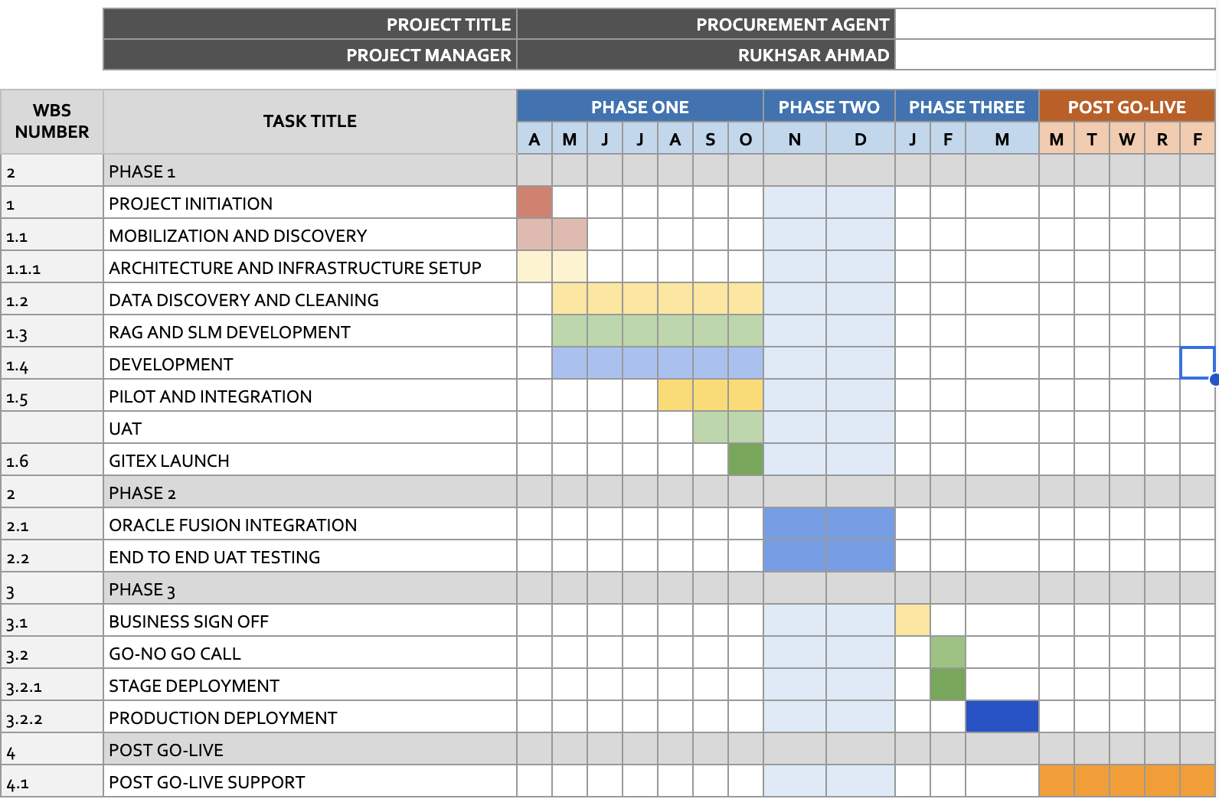
Gantt Chart

Slide 15
Part B: Technical Implementation

Slide 16
Technical Spec: Model Selection and Logic
The Model Decision: Moving away from massive models (like GPT-4/Large Foundation) towards Lighter Models (SLMs) like IBM Granite and Jais-30B.
  Primary: Jais-30B (Sovereign Arabic model) for local nuance (G42 & MBZUAI) - Purpose-built for UAE Arabic. It understands "Sharia-compliant" procurement and local legal terminology that Western models hallucinate.
  Secondary: IBM Granite - Optimized for "Business Tasks" (RFP drafting, summarization). It is significantly cheaper to run and has a smaller memory footprint for sovereign hosting.
Reasoning:
  Cost: Granite offers lower inference costs (AED/Token) for high-volume government tasks.
  Latency: Faster response times for procurement officers.
  Accuracy: Jais-30B is purpose-built for Arabic legal context; Granite is optimized for enterprise data extraction.
  Sovereignty: 100% Data Sovereignty on Azure UAE North.

Slide 17
Technical Spec: Orchestration - LangGraph
Why LangGraph for Abu Dhabi Government?
State Management:
LangGraph excels at "persistence." If a procurement officer starts an RFP drafting session, leaves, and comes back 2 hours later, the Agent remembers exactly where it left off in the workflow.
Controlled Agency:
Unlike "autonomous" agents that can go off the rails, LangGraph allows you to define strict flow control. You can ensure the Agent must pass a "Compliance Check" node before it is allowed to reach the "Draft Finalized" node.
Human-in-the-loop (HITL):
LangGraph has "interrupt" capabilities. The Agent can pause and wait for a human (the Procurement Officer) to approve a vendor selection before proceeding to the next step.

Slide 18
Technical Spec: RAG & Vector Strategy
Vector Database:
Azure AI Search
Index:
Storing 8 years of procurement history as high-dimensional vectors.
Retrieval:
Using "Hybrid Search" to combine semantic meaning with legal keyword exact-matches.
Guardrails:
Hallucination filters ensuring every output is traceable to an source document.

Slide 19
Technical Spec: Oracle Integration
Protocol:
Utilizing Model Context Protocol (MCP) for secure, standardized tool-use.
Connectivity:
OCI-Azure Interconnect private link. MCP Servers provide the interface to Oracle Fusion REST APIs.
Data Flow:
Bi-directional sync for Purchase Orders, Budget status, and Vendor Master data.
Latency:
Sub-second data retrieval through optimized API handshakes.
Advantage:
Decouples the AI from the API, allowing for modular updates and scaling.

Slide 20
Technical Spec: Security & Compliance
• Identity:
Seamless integration with UAE Pass for single-sign-on (SSO).
• Security:
AES-256 Encryption at rest; TLS 1.3 in transit; Private Link access only.

Slide 21
Technical Spec: Deployment & Scaling
• Containerization:
Using Kubernetes (AKS) to scale pods across 15+ entities.
• Deployment:
Continuous Integration/Deployment (CI/CD) with Blue-Green strategies.
• Performance:
Optimized for <60s full document generation.

Slide 22
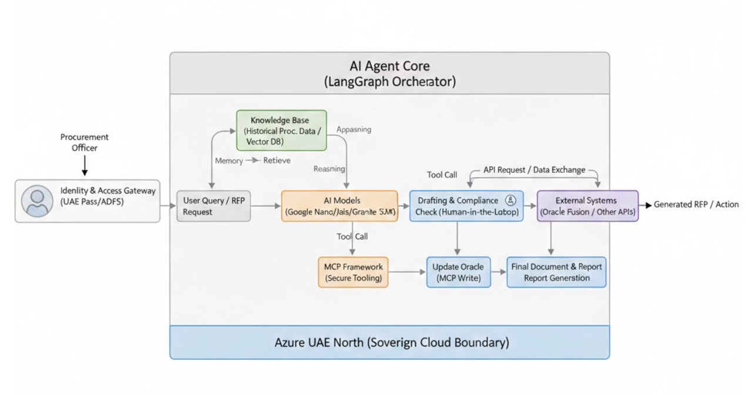
Technical Spec: High Level Architecture

Slide 23
Part C: Risk Management and Problem Solving

Slide 24
Scenario 1: The ERP Upgrade Crisis
• Event:
Unplanned 6-week Oracle upgrade downtime during the dev phase.
• Risk:
Threatens the October GITEX deadline and Phase 1 delivery.

Slide 25
Scenario 1: Shadow API Resolution
• TPM Decision:
Decouple Phase 1 development from the live Oracle environment.
• Action:
Build a mock-API (Shadow API) using high-fidelity data snapshots.
• OUTCOME:
AI brain development continues uninterrupted; GITEX launch is protected.

Slide 26
Scenario 2: The Arabic Accuracy Crisis
• Event:
Arabic accuracy at 65% vs 95% target; Vendor requests + Budget increase by 40%
• Decision:
Reject Vendor request to protect the AED 2.8M budget cap.
Fiduciary Responsibility to protect government budget.
Optimization Strategy:
Moving from Zero-Shot to Few-Shot Prompting using local high-quality legal templates.
Technical Pivot:
Implementing Semantic Re-ranking (Cohere/BGE) to ensure the RAG only retrieves the most relevant Abu Dhabi legal clauses.

Slide 27
Scenario 2: Prioritizing Budget Integrity & Performance
• Action:
Pivot to internal Hybrid RAG tuning (Jais-30B) and Human-in-the-loop (HITL) review.
• Viewpoint:
Internal expertise + Lighter models (SLM) solve accuracy without extra costs.
• Outcome:
Phase 3 Go-Live remains on track for Q1 2026.

Slide 28
Impact Assessment (Financial/Schedule)
• Schedule:
All Phase milestones (Oct, Dec, Mar) remain intact.
• Budget:
AED 2.8M limit maintained; Contingency used for in-house tuning.

Slide 29
Mobilization: The First 30 Days
• Week 1:
Team onboarding,Training & Azure Infrastructure provisioning.
• Week 2:
Oracle API discovery and 20% Data Quality audit.
• Week 3:
Deployment of Sprint 0; Initiation of first Data Cleansing sprint.
• Week 4:
Completion of the environment setup and Development initiation.
Baseline 'RAG Answer Relevancy' score of >70% on a sample of 100 historical RFP documents.

Slide 30
Conclusion: Delivering the AI Factory
Commitment:
On-time, on-budget delivery of a sovereign AI ecosystem.
Vision:
Positioning the Abu Dhabi Government as a global leader in AI-driven operations.
Call to Action / Next Step:
Immediate mobilization for April 1st start date.
Future Outlook (Phase 4):
Expanding to a 'Self-Service Vendor Portal' where vendors use AI to verify their own compliance before submission

